Slide 1
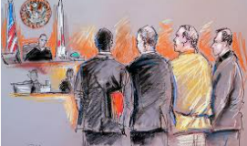
AI for Recidivism and Judicial outcomes
Sushika Reddy Gade
1361635

Slide 2
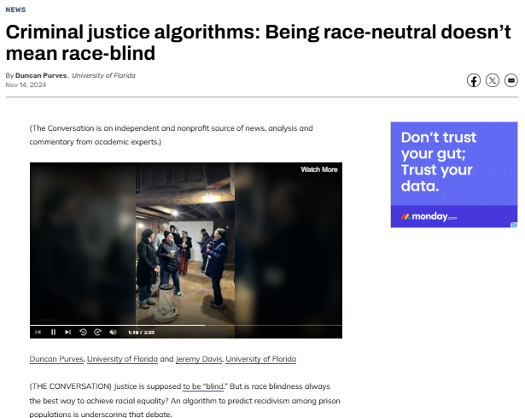
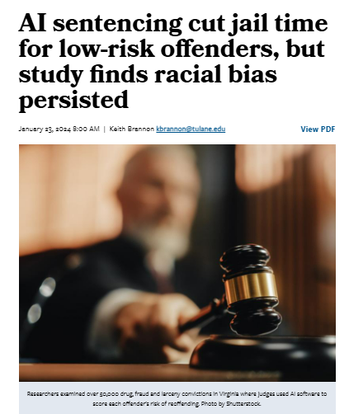
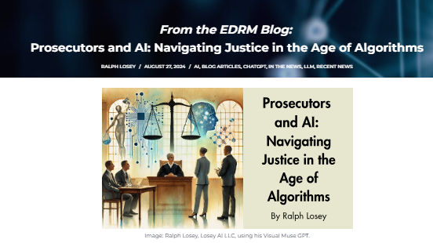
What is Recidivism – Judicial Outcome Ethical Issues
https://news.tulane.edu/pr/ai-sentencing-cut-jail-time-low-risk-offenders-study-finds-racial-bias-persisted
https://edrm.net/2024/08/prosecutors-and-ai-navigating-justice-in-the-age-of-algorithms/
https://www.nhregister.com/news/article/criminal-justice-algorithms-being-race-neutral-19916473.php

Slide 3
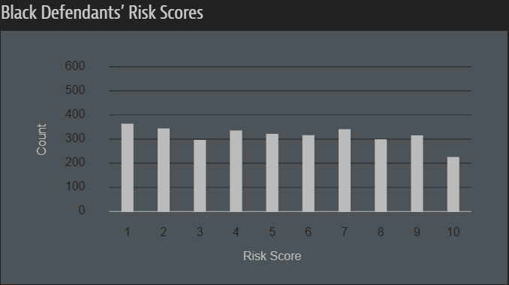
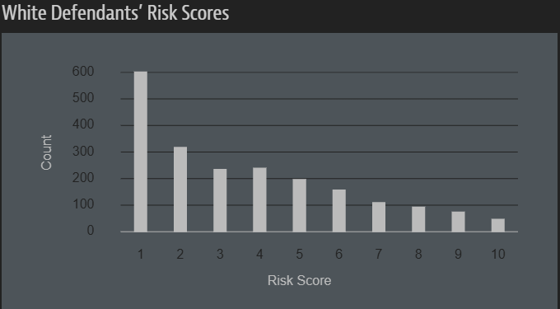
COMPAS for predicting Recidivism
Algorithm named COMPAS (Correctional Offender Management Profiling for Alternative Sanctions), was developed by Northpointe (now Equivant) to predict the likelihood of a criminal defendant to commit another crime.
Black defendants were often predicted to be at a higher risk of recidivism than they actually were.
Higher Risk Misclassification for Black Defendants
Lower Risk Misclassification for White Defendants
Violent Recidivism Misclassification
https://www.propublica.org/article/how-we-analyzed-the-compas-recidivism-algor

Slide 4
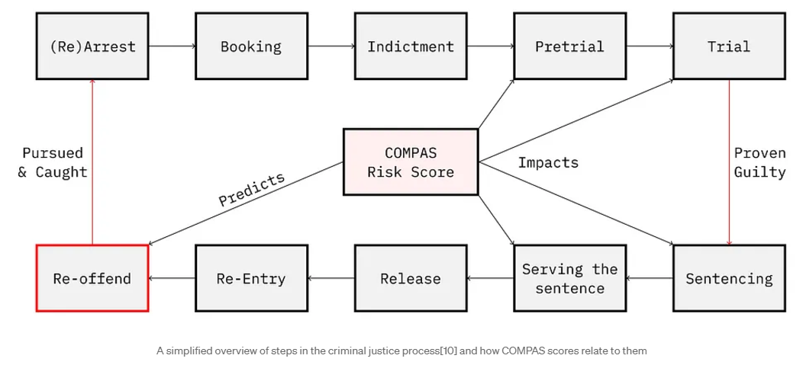
How COMPAS scores impact in Criminal justice process
https://medium.com/@lamdaa/compas-unfair-algorithm-812702ed6a6a

Slide 5

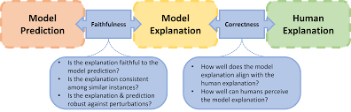
Goal of the project: To build an Ethical AI Judicial System
Training on elaborate datasets to avoid biases
Emphasis on fairness in decisions
Mitigating biases: racial biases, socio-economic biases, age-specific biases.
An accountable platform that supports its own decisions and showcases explainability.
Emphasizing human intervention for crucial decisions and not blindly following the model decisions.

Slide 6
High level Diagram of the platform
AI model
Elaborate and inclusive dataset
Recidivism prediction algo independent of biases
Predictions/ judgements with reasoning
Judges' decision with reasoning
Explain why/why not?

Slide 7
AI ethics Principles
AI ethics is a set of guidelines that advise on the design and outcomes of artificial intelligence systems.
It majorly focuses on the following principles:
Non-Maleficence (Do no Harm)
Responsibility or Accountability
Transparency or Explainability
Justice or Fairness
Human rights – Privacy and Security
Prof. Arup Das

Slide 8
HCD and mock AI audit
HCD
Mock AIA
1 Is there a need for a tool to predict recidivism?
2.Are there any parts of the AI that you do not trust to assist in predicting recidivism?
3. Do you think that this application will serve its purpose well?
4. What concerns do you have regarding privacy of your personal information?
5. Has current technology for predicting recidivism proven beneficial to judicial practices?
7. Would the platform influence your judgement plan for the person?
8. What are your thoughts on technology mitigating bias within judicial systems and decision making?
9. Have you considered recidivism an ethical issue?
1. What are the needs of the people and are they being met?
2. Does AI provide value to any potential solution?
3. What is the potential harm if any?
4. Provide ways to challenge the system.
5. What are the built in Safety Measures?

Slide 9
Platform performance in compliance with AI-ethics Principles
Fairness: In our model the predictions are fair to all the parties i.e irrespective of race, socio-economic status, sex etc.
Accountability: In our model a clear and elaborate model card is provided showcasing accountable and responsible model building
Mitigating Biases: Training our model on elaborate databases tackling any discrepancies in our training data and, hence providing an unbiased decision-making model.
Transparency: Providing all supporting situations that led to a decision, i.e if a person can potentially commit a crime again or not.
Data Privacy and Security: Abiding by all the privacy and security laws and not collecting or using any unnecessary data that does not play any role in decision making process.
Prof. Arup Das

Slide 10
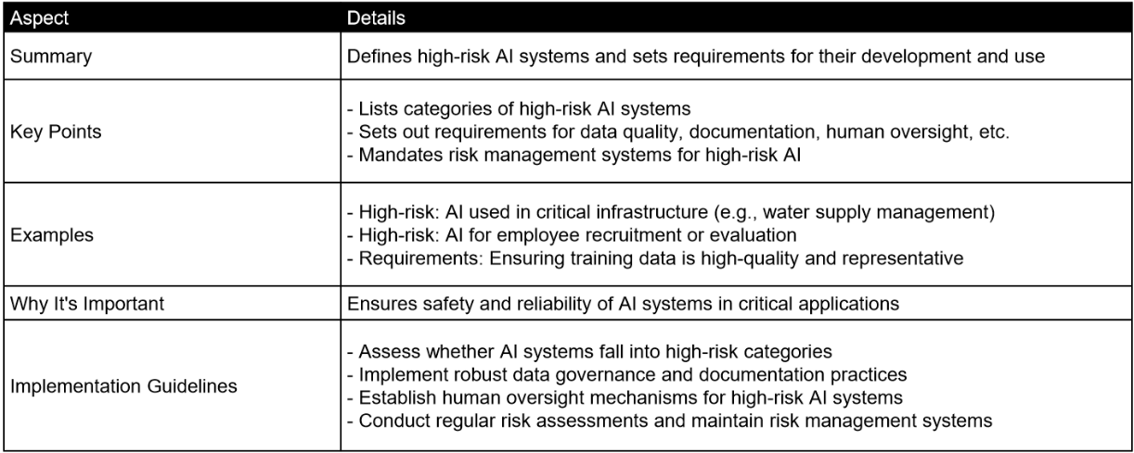
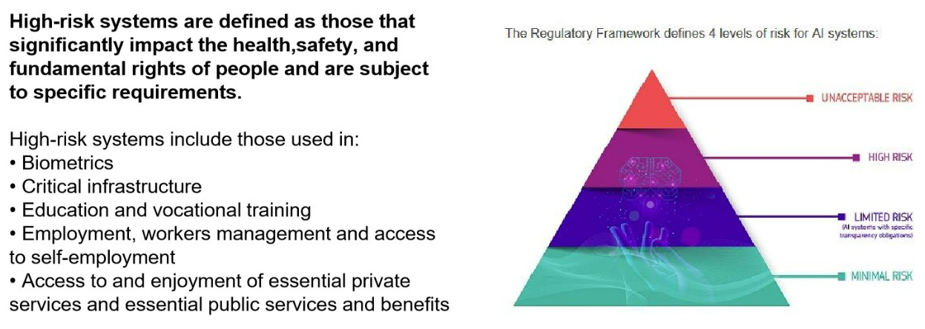
Compliance Laws for a High Risk – AI system:
Prof. Arup Das

Slide 11
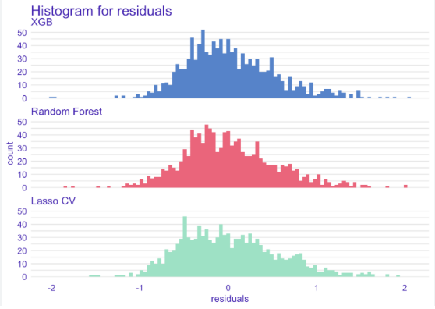
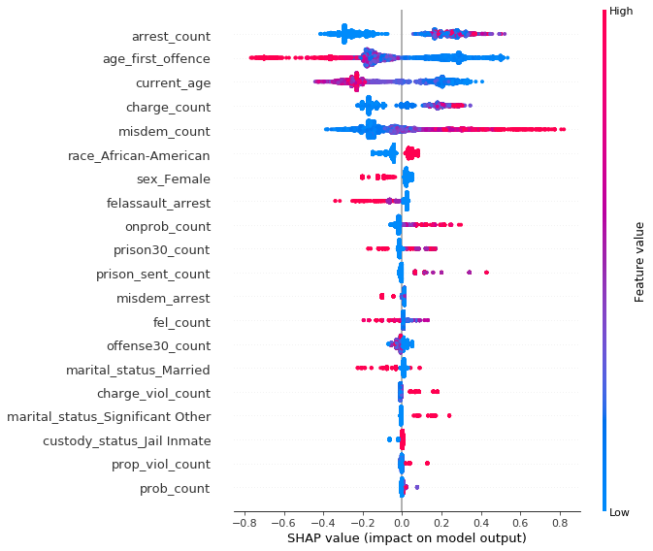
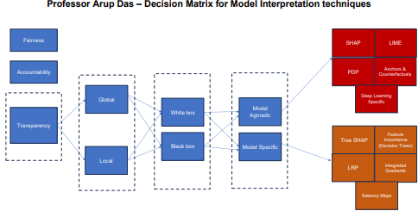
Interpretation Techniques
Prof. Arup Das
https://pbiecek.github.io/xai_stories/story-heloc-credits.html
https://pbiecek.github.io/xai_stories/story-compas.html#fairness

